Slide 1
Chapter Training Webinar:
Adding Value to Chapter Events with Continuing Education
Tuesday, October 17, 2017 at 1:00 pm EDT
Sheila McCoy – Director, Continuing Education
Susan Emert – Manager, Member & Chapter Services

Slide 2
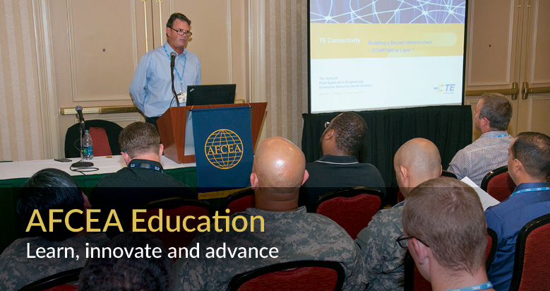
Agenda
Why does AFCEA support continuing education?
How do chapters get on board?
What tools are available to assist chapters?
What are the lessons learned/best practices?

Slide 3
Background
Continuing education supports many required certifications
Focus
Cybersecurity
Government, especially DoD requirements
Maintaining a required certification is often an acceptable justification for event attendance
Notes:
AFCEA launched our program to get continuing education approvals for event and course content at WEST 2012. In FY 2013 we expanded the program to include chapter events.
The program is based on but not limited to providing continuing education support for attendees who need to maintain cybersecurity certifications mandated by Department of Defense. The DoD guidance applies to government and industry individuals who have certain positions pertaining to DoD networks and data. While organizations overseeing these certifications used to follow a “certified for life” approach and then changed to a requirement to maintain certifications with continuing education. Certifications will expire for those who don’t maintain them. As a result, getting or maintaining a certification is often an approved reason to attend an event with continuing education.

Slide 4
Participating Organizations
CompTIA
Continuing education units (CEU)
Currently supports A+, Network+, Security+, CSA+, Cloud+ and CASP
Global Information Assurance Certification (GIAC)
Certification arm of SANS Institute
Continuing professional education (CPE)
Supports GIAC family of certifications
Notes:
Different organizations use varying terms to measure the value of continuing education to their certification programs.
We are now using the overall terms, “continuing education” and “certification maintenance.”

Slide 5
What About Other Certifications?
Defense Acquisition University
DAU considers AFCEA a training provider for Acquisition Workforce
Workforce members should check with their supervisor for training questions
Other certification authorities such as (ISC)² and PMI suggest we say our sessions “may” support their requirements
Notes:
AFCEA has no formal review and approval relationship with any other certifying organizations. Several organizations have authorized us to say our program “MAY” support their certification maintenance requirements.
It is best to refer those inquiring to the certifying authorities’ websites for specific questions and requirements.

Slide 6
What About Webinars?
AFCEA has coordinated with certifying organizations about attendance records
We plan to experiment with SIGNAL webinars
Use “self-certification” model initially
We can validate attendance for chapter groups which participate together in an approved webinar – if the participation is observed and validated by a chapter officer
Notes:
We are working with our certifying organizations toward ways they might accept attendance records for webinars.

Slide 7
Why Extend to Chapters?
Strengthen events
Support community
Help attendees justify participation
Build membership
Notes:
Because certification maintenance is a requirement for many government and industry professionals approved sessions help draw those professionals to AFCEA events and often helps tip the scale toward approval to attend an event.
Since attendance documentation is a benefit of AFCEA membership for applicable sessions, this helps add value to our individual memberships and can be an incentive to join AFCEA.
Approved sessions can help add credibility to an event.

Slide 8
How Chapters Engage
Select sessions
At least one hour of content
Best topics – cybersecurity, info/data/network technology & management
Classes, panels, speakers, workshops
Submit review request to AFCEA - https://www.afcea.org/secure/cesubmission.cfm
Use approval info to promote event
Take attendance, run membership check and submit attendance list to AFCEA
Notes:
ONE HOUR of content is the minimum for approval.
Topics are not limited to cybersecurity.
Cybersecurity
Telecommunications
Data communications and management
Information technology
For the best support for the event, submit continuing education review requests as early as possible.
Chapter takes attendance at close of each session and sends typed spreadsheet to AFCEA staff who send formal emails documenting attendance.
Attendees are responsible for submitting to the certifying organization and some costs may apply.

Slide 9
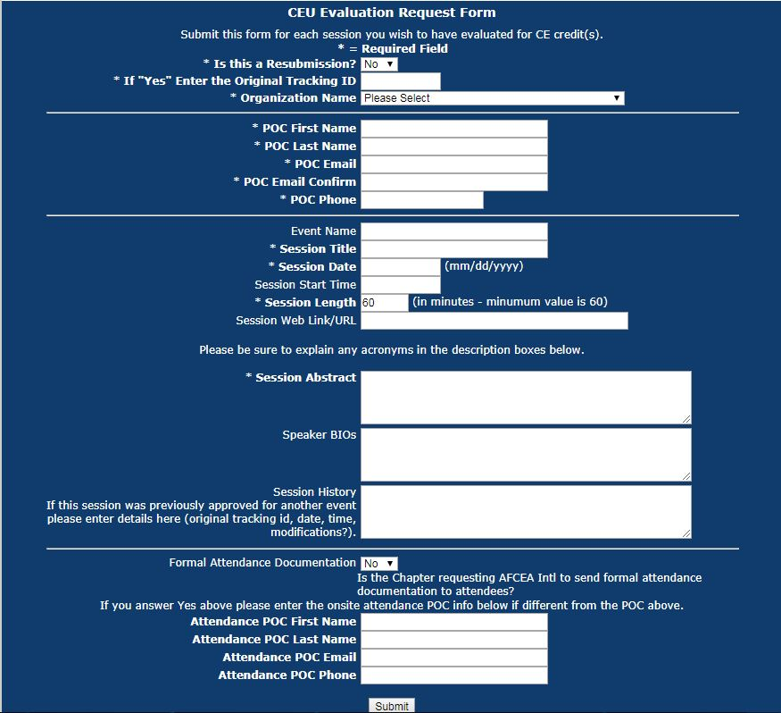
Notes:
Use online form https://www.afcea.org/secure/cesubmission.cfm
Panel Name:
Brief Description (3-4 sentences, list sub-topics if it might be helpful).
First sentence should explain why the topic is important in terms of a threat, challenge, solution, or opportunity and the following sentences can amplify. Final sentence should summarize what attendees can expect to hear and/or discuss.
Spell out acronyms on first use.
Moderator/speaker name, title, and 2-3 sentence bio.
Panelists (with job title and organization).

Slide 10
Best Practices
Use a regional approach – examples: Walker First sponsored classes
Carolinas Region
Georgia Region
Work with an AFCEA International event
Augusta-Fort Gordon Chapter
Hawaii Chapter
Designate a chapter officer for oversight
Notes:
RVPs Jane Brightwell and Col Patricia J Harrington, USAF (Ret.), both with Walker First, have worked out a great approach for companies to offer short classes for chapters. We are working toward a standard approach for chapters to coordinate with Walker First for classes which already have continuing education approval.
The Augusta-Ft Gordon Chapter and the Hawaii Chapter offer classes in conjunction with AFCEA International events.

Slide 11
How Headquarters Supports
Guides review of chapter submissions with certifying organizations
Provides review results and recommended wording for promotion
Sends attendance documentation to AFCEA members if requested by chapter
Notes:
AFCEA International is responsible for oversight and growth of the program.

Slide 12
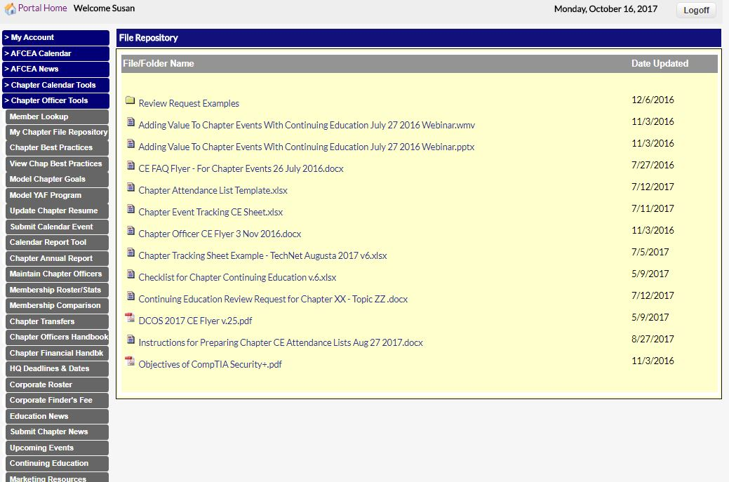
Information at HQ
Notes:
While we only grant access to chapter officer tools to AFCEA members designated by chapter officials some chapters using support organizations have requested access for AFCEA members in those organizations.

Slide 13
Lessons Learned
Start early to get most benefit
Prepare abstracts carefully
Introduce topic as it relates to a threat, challenge, opportunity, or solution
Spell out all acronyms
Session description is most important
Use approval info in promotion
Type attendance records and check membership status
If in doubt, ask for help!

Slide 14
Coming Attractions
Use of an online form for submitting review requests **Available Now**
An online “catalog” of approved Walker First classes you may request
Annotations for calendar events with approved CE sessions
Additional support for chapter event marketing

Slide 15
CE Helps Boost Membership
CE sessions provide a strong incentive to attend an AFCEA event and become a member
CE attendance documentation is valuable to Military, Civil Service and government consultants
Notes:
AFCEA can provide formal attendance documentation to AFCEA members who attend approved sessions.
Please see key documents on the portal in Chapter Officer Tools.

Slide 16
Questions ?
Please contact us
Sheila McCoy - Coordinate program, work with certifying organizations
Director, Continuing Education
(703) 631-6135
smccoy@afcea.org
Susan Emert - Guide Chapters
Manager, Member & Chapter Services
(703) 631-6191
semert@afcea.org
http://www.afcea.org/site/?q=education/continuing-education-credits

